Slide 1

Drought Management – A multi pronged approach
VANDANA RAO
Director of Water Policy
MA Energy & Environmental Affairs
March 11, 2021

Slide 2
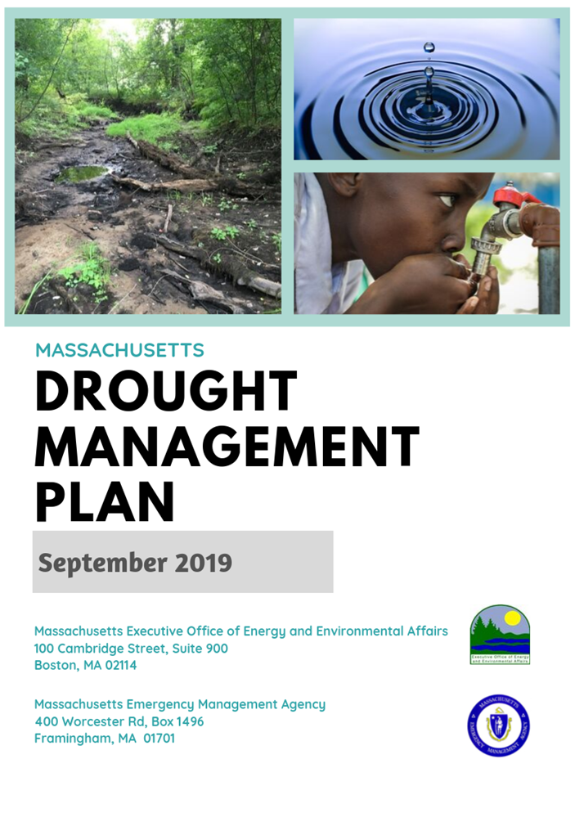
Updated MA DROUGHT PLAN Developed after 2016/17 Drought

Slide 3
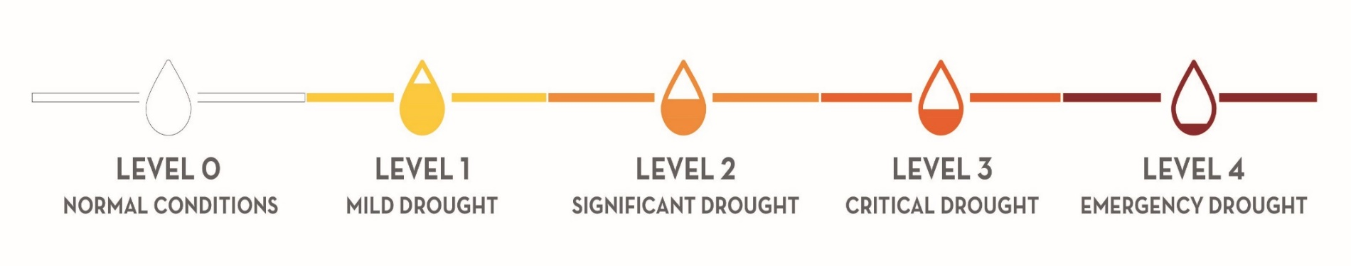
MA Drought Management Plan
Drought Levels

Slide 4
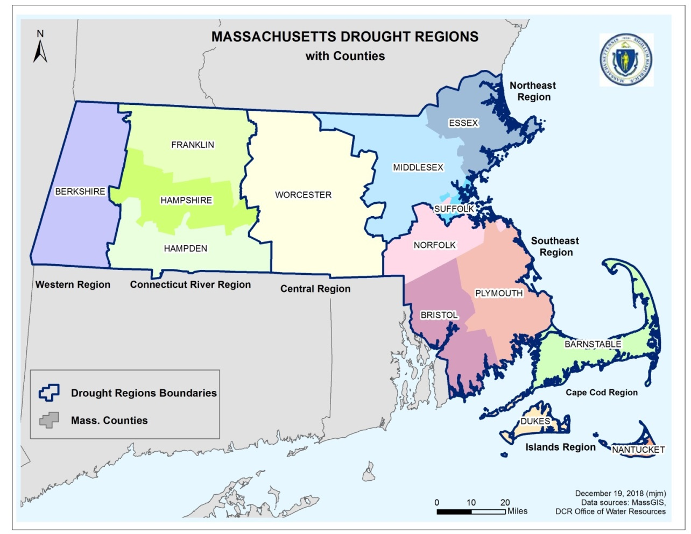
Notes:
Indices and drought levels are looked at for each drought region. DRs as you’ll recall have been aligned with county boundaries and the Cape and Islands separated into two regions – cape cod; islands. Brookline is the exception because it belongs to Norfolk county but is physically located within Suffolk county and Northeast DR. It remains located in NE DR where it is physically located and hydrologically connected to its physical neighbors.

Slide 5
MA Drought Indices
Precipitation (59)
Streamflow (59)
Groundwater (64)
Lakes and Impoundments (19)
KBDI- Fire Danger (16)
Crop Moisture (national map)
Numbers in parenthesis indicate number of data points across the state

Slide 6
Topics Reported
Hydrologic Conditions
Weather & Forecast
Water Supply Impacts
Environmental Impacts
Agricultural Impacts
Fire Danger
Engineering/ Infrastructure Impacts
Public Health Impacts

Slide 7
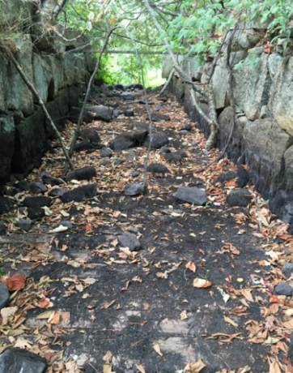
Drought Preparedness and Response Actions: Guidance for Communities
Identifies key actions that can be taken at the local level before a drought (to prepare) and during a drought (to respond), along with resources to implement key actions
Audience: municipalities and/or public water systems, partners that can support and assist with implementation, including environmental groups, concerned citizens, and local boards such as the planning board, conservation commission, and town select board or city council
Action 1: Develop a Water Conservation Program
  Outdoor Water Use Program that includes Land-Use Planning –
  to decrease impervious cover and increase recharge; LID
Action 2: Develop a Local Drought Management Plan
Third Herring Brook,
Norwell

Slide 8

State Drought Guidance
State Drought Condition (by Region) | Nonessential Outdoor Water Use Restrictions
Level 1 (Mild Drought) | 1 day per week watering, after 5 p.m. or before 9 a.m. (to minimize evaporative losses)
Level 2 (Significant Drought) | Limit outdoor watering to hand-held hoses or watering cans, to be used only after 5 p.m. or before 9 a.m.
Level 3 (Critical Drought) | Ban on all nonessential outdoor water use
Level 4 (Emergency Drought) | Ban on all nonessential outdoor water use
The actions in this table apply to all outdoor water users
and represent one of the most effective ways to minimize
the impacts of drought on water supply and the environment.

Slide 9
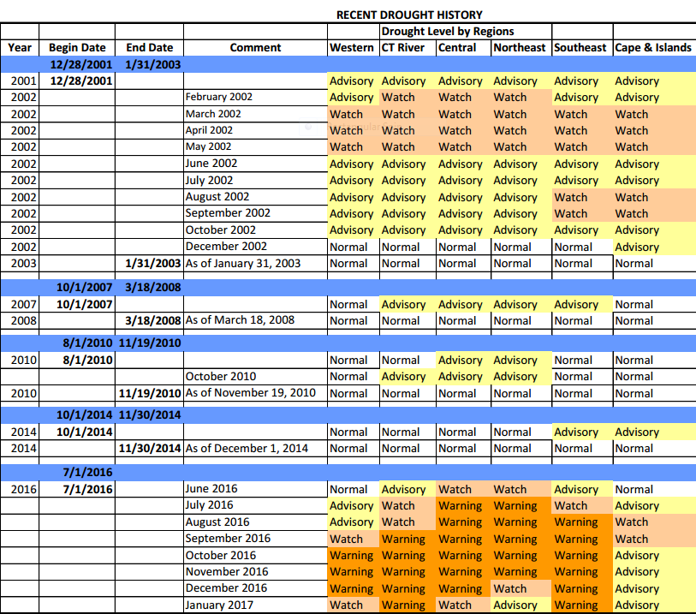
Droughts in Recent Years

Slide 10
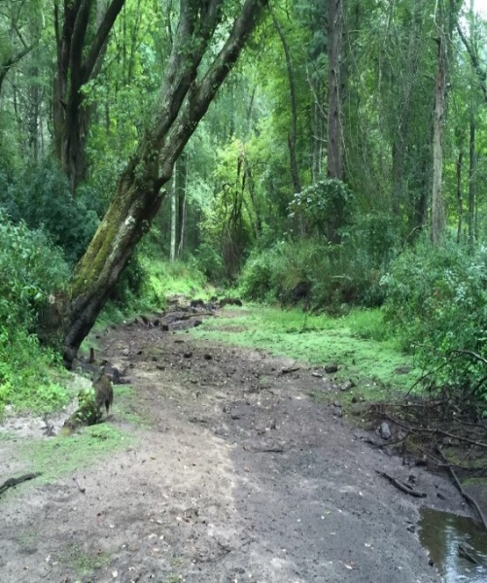
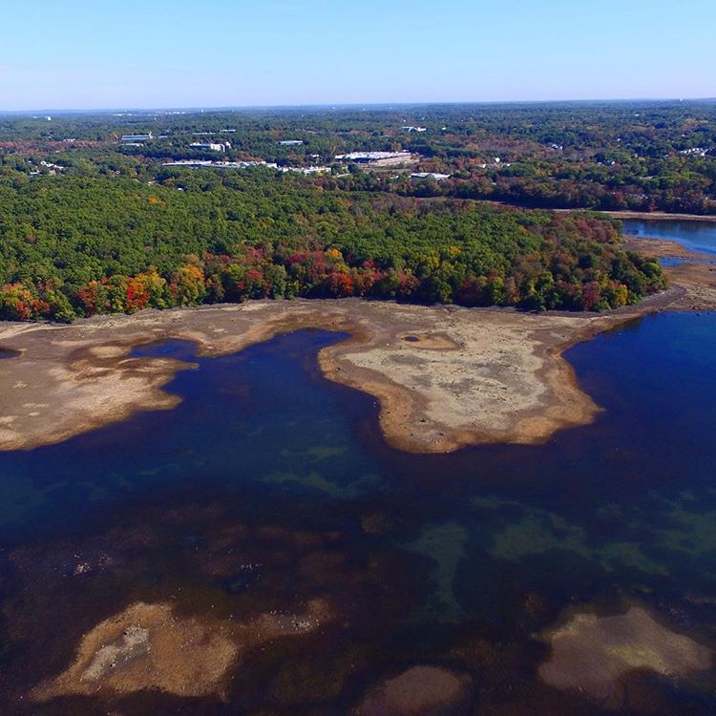
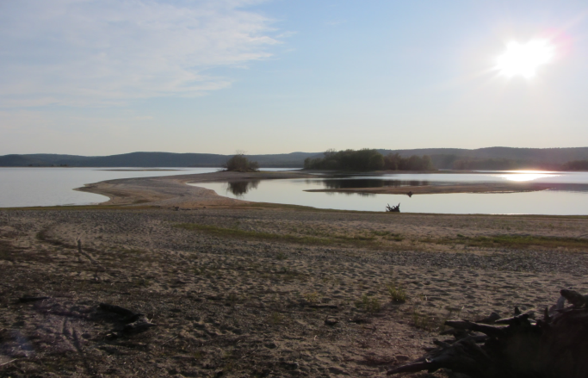
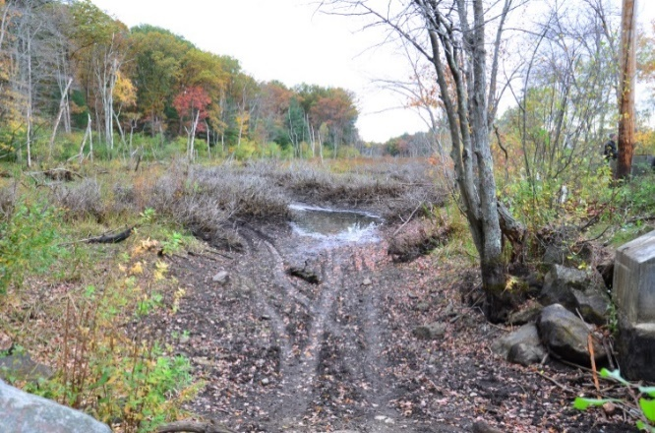
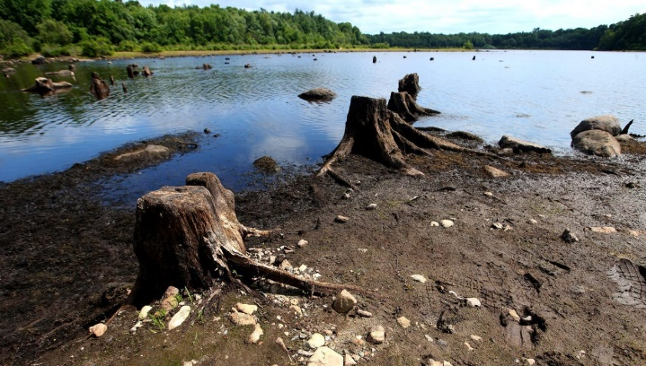
Our most severe drought since the 1960s
Mattapoisett River September 2016
Cambridge Reservoir
Fall 2016
Quabbin Reservoir
September 2016
Martins Brook
Fall 2016
Scituate Reservoir
2016

Slide 11
The Drought of 2016 - 2017
July 2016
August
September
October
November
December
January 2017
February
March
April
May 2017

Slide 12
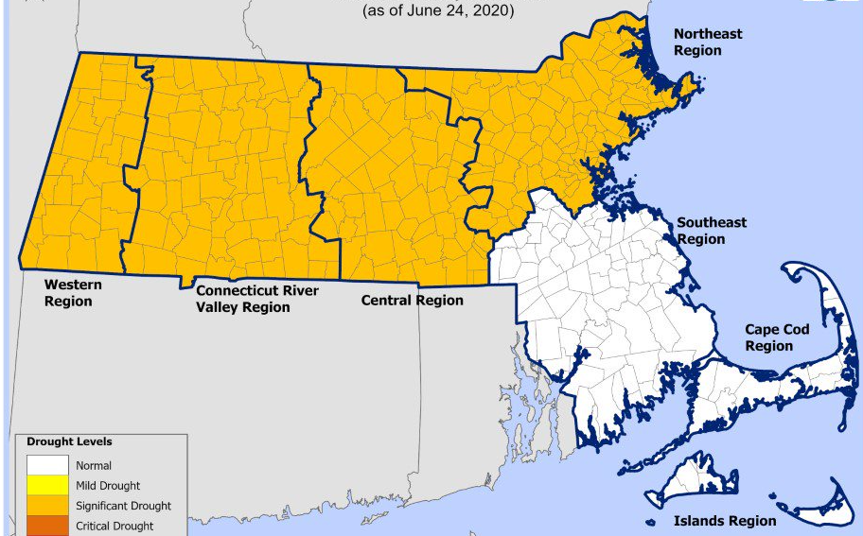
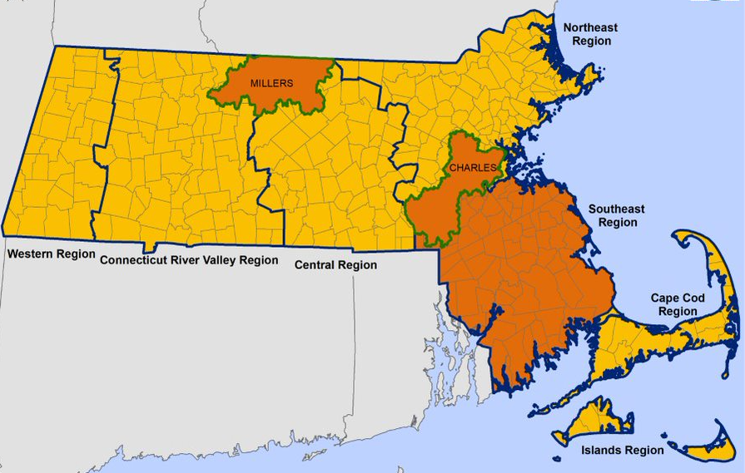
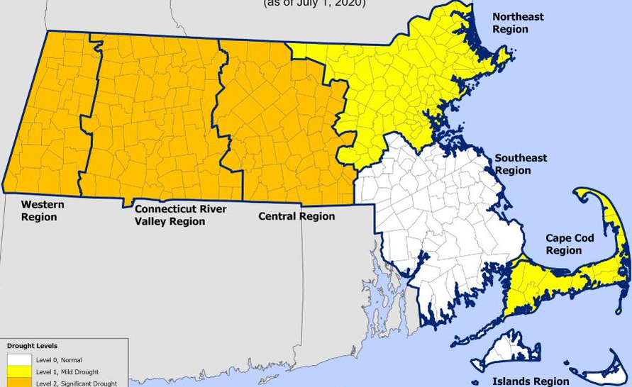
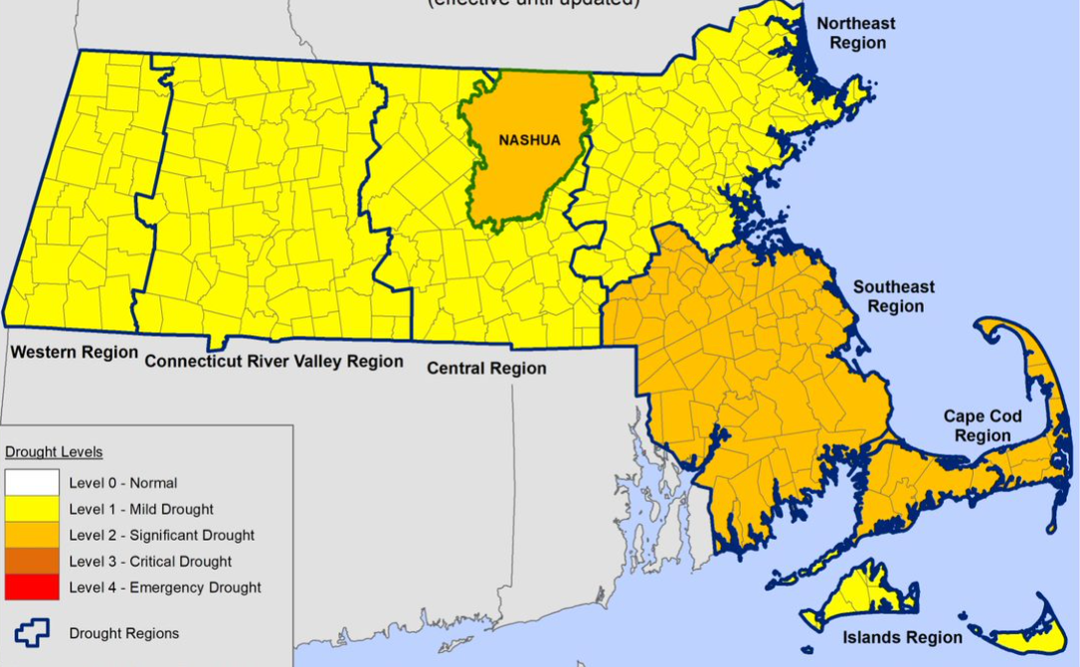
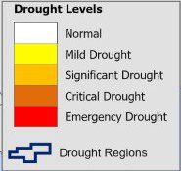
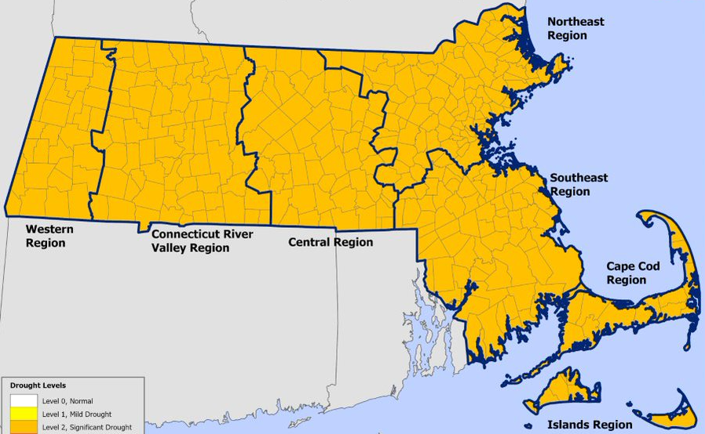
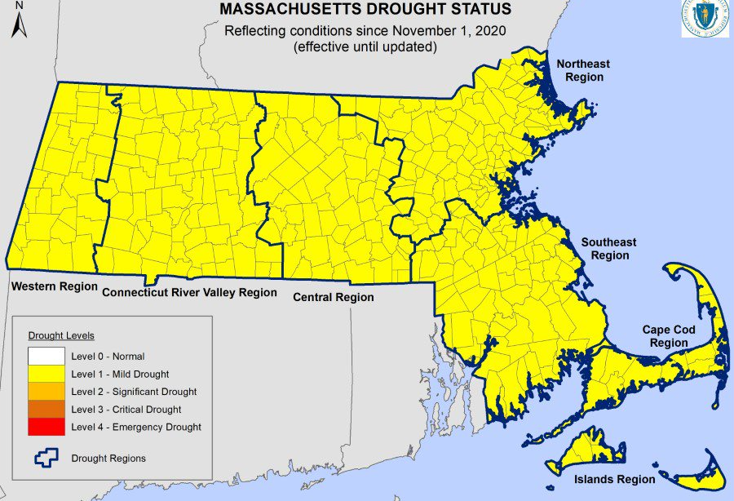
The
Drought of 2020
May
September
October
June
November
July & August

Slide 13
Streamflow Record Lows
2016-2017 Drought
2020 Drought
Month | # Gages with Period Of Record Lows | # Gages with SF between 2-10 Percentile
September 2016 | 15 | 41
October | 2 | 23
November | 2 | 30
December | 1 | 9
January 2017 | 0 | 0
February | 0 | 0
March | 1 | 10
Month | # Gages with Period Of Record Lows | # Gages with SF between 2-10 Percentile
June 2020 | 0 | 24
July | 0 | 1
August | 3 | 14
September | 1 | 22
October | 0 | 4
November | 0 | 0

Slide 14
Groundwater Record Lows
2016-2017 Drought
2020 Drought
Month | # Wells with Period Of Record Lows
September 2016 | 14
October | 13
November | 8
December | 6
January 2017 | 4
February | 3
March | 2
Month | # Wells with Period Of Record Lows
June 2020 | 4
July | 1
August | 2
September | 6
October | 6
November | 2
Annual Precipitation
2016 – 37 inches; 2017 – 47 inches
Average per year: 48 inches
Rainfall during the drought of record (1960s) – low 30s

Slide 15

Take-Aways from 2016 & 2020 Droughts
Climate is changing and MA is predicted to see more short- and long-term droughts
Have started to experience a newer phenomenon of a “flash drought” with a fast onset and quick deterioration in conditions
Consistently above normal temperatures – contribution to flash droughts, more evaporation, winter precipitation as rain, greater outdoor use
Seen many record low streamflow and groundwater levels across the state (worse than during the drought of the 60s) in spite of rainfall amounts being higher
Need to have a consistent approach to drought planning and mitigation, and communication
We need to manage land use
better and be more PREPARED!!
Mattapoisett River, September 2016
(Photo credit:Steve Hurley)

Slide 16
In Addition, we are also seeing that…

Slide 17
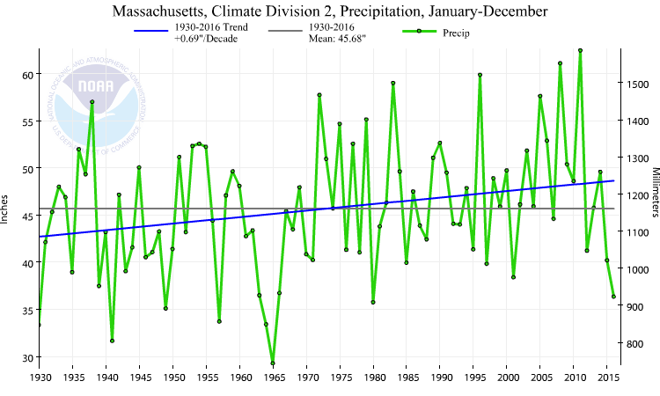
Extremes!
CT Valley to Merrimack Valley
Source: http://www.ncdc.noaa.gov/cag

Slide 18
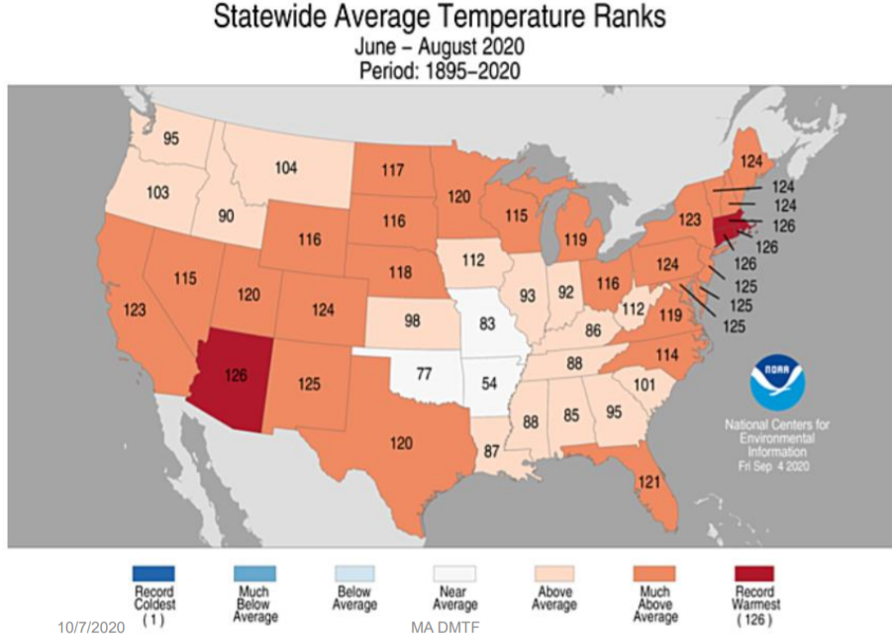
Temperatures are Rising!

Slide 19
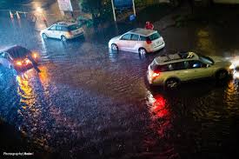
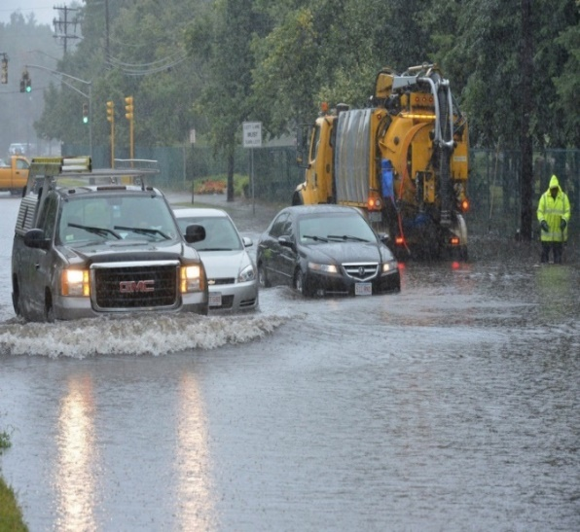
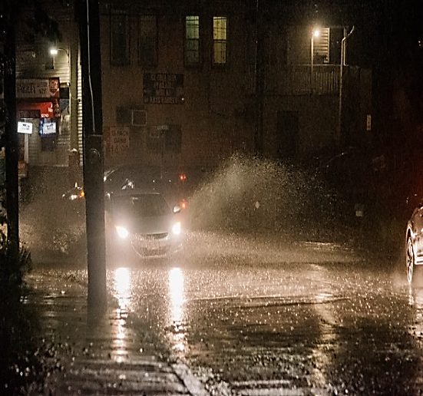
And this…….Worcester in October 2016
....while we were in the middle of our worst drought since the 1960s!
Level 4 DROUGHT WARNING

Slide 20
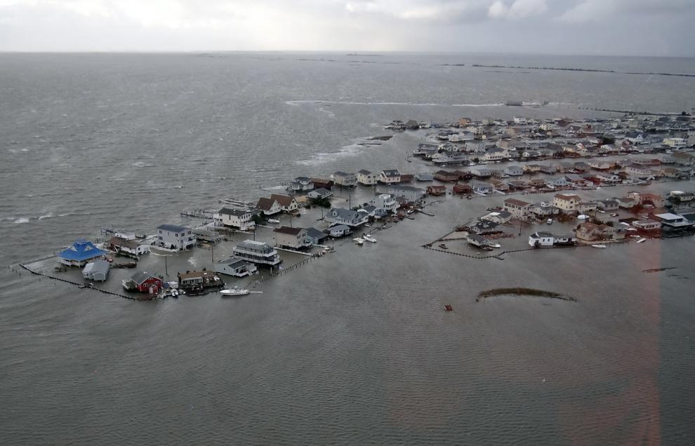
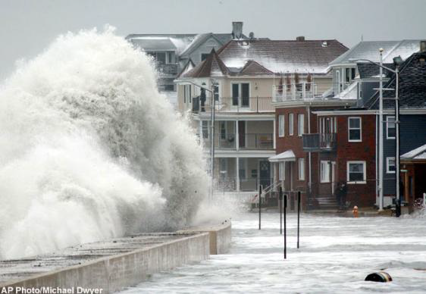
Sea Level Rising and Increased Storm Surge!

Slide 21
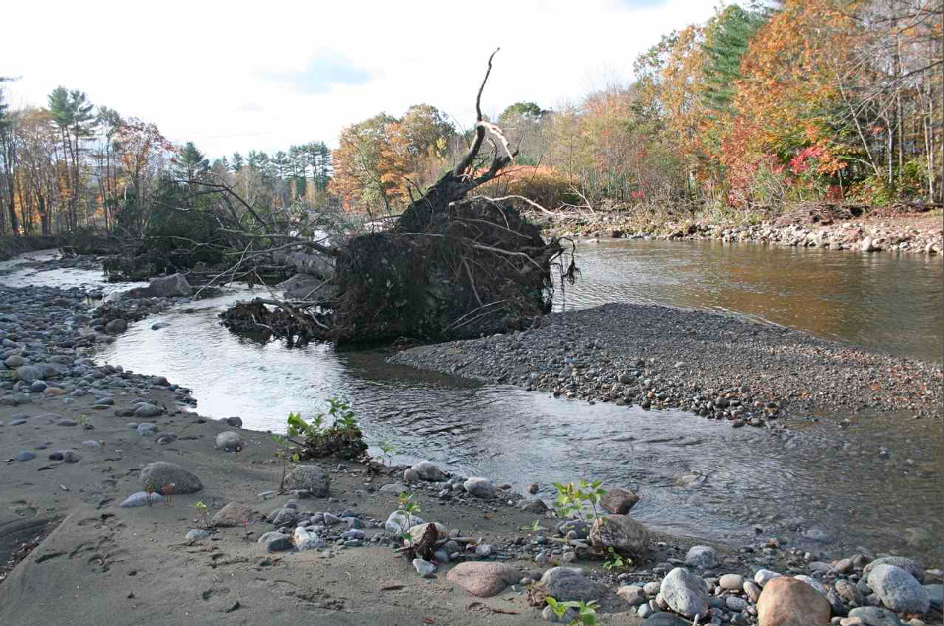
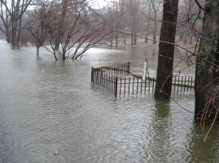
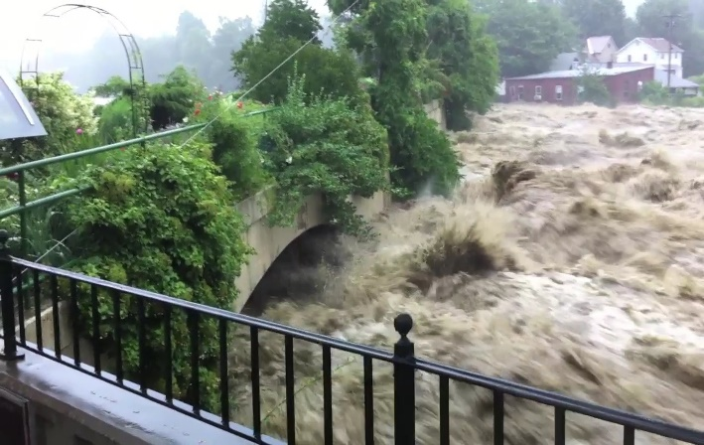
High Intensity Rains resulting in Flooding!
Photo from J. Field
Source: Steve Mabee

Slide 22
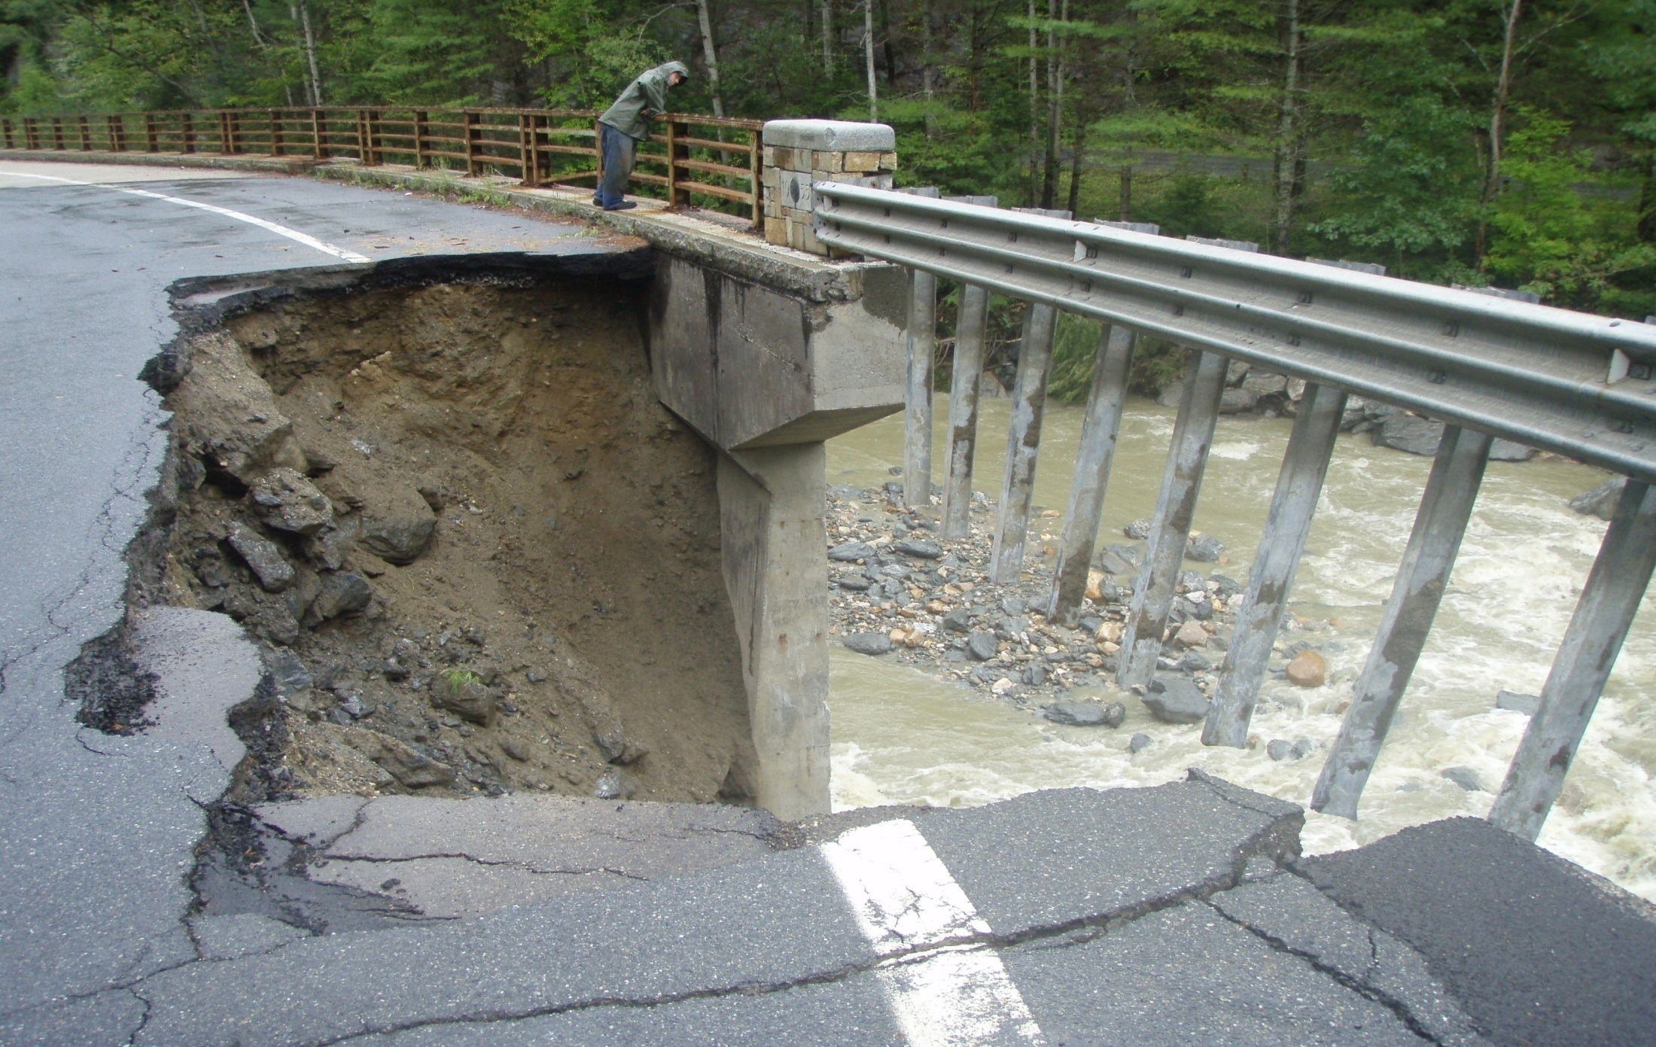
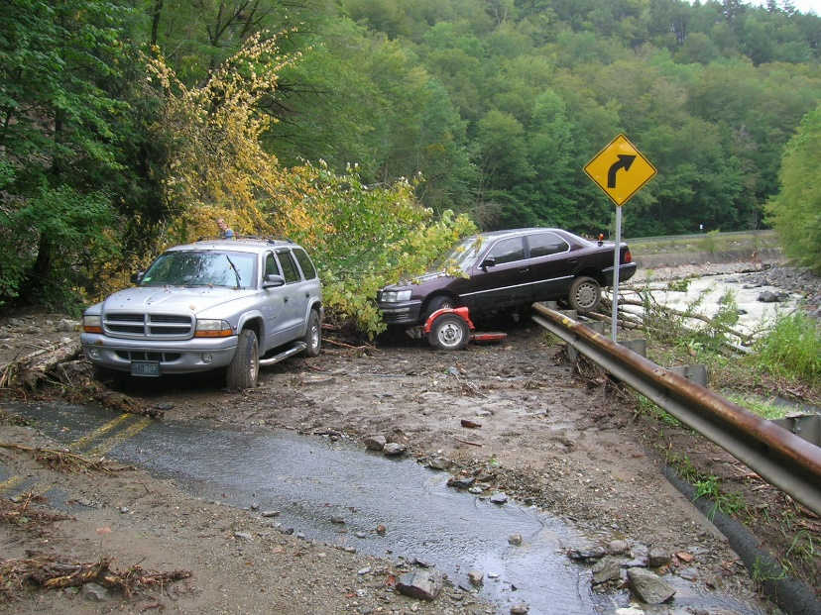
Infrastructure and Property Damage!
Photo: J. Kopera
Photo: Steve Mabee

Slide 23
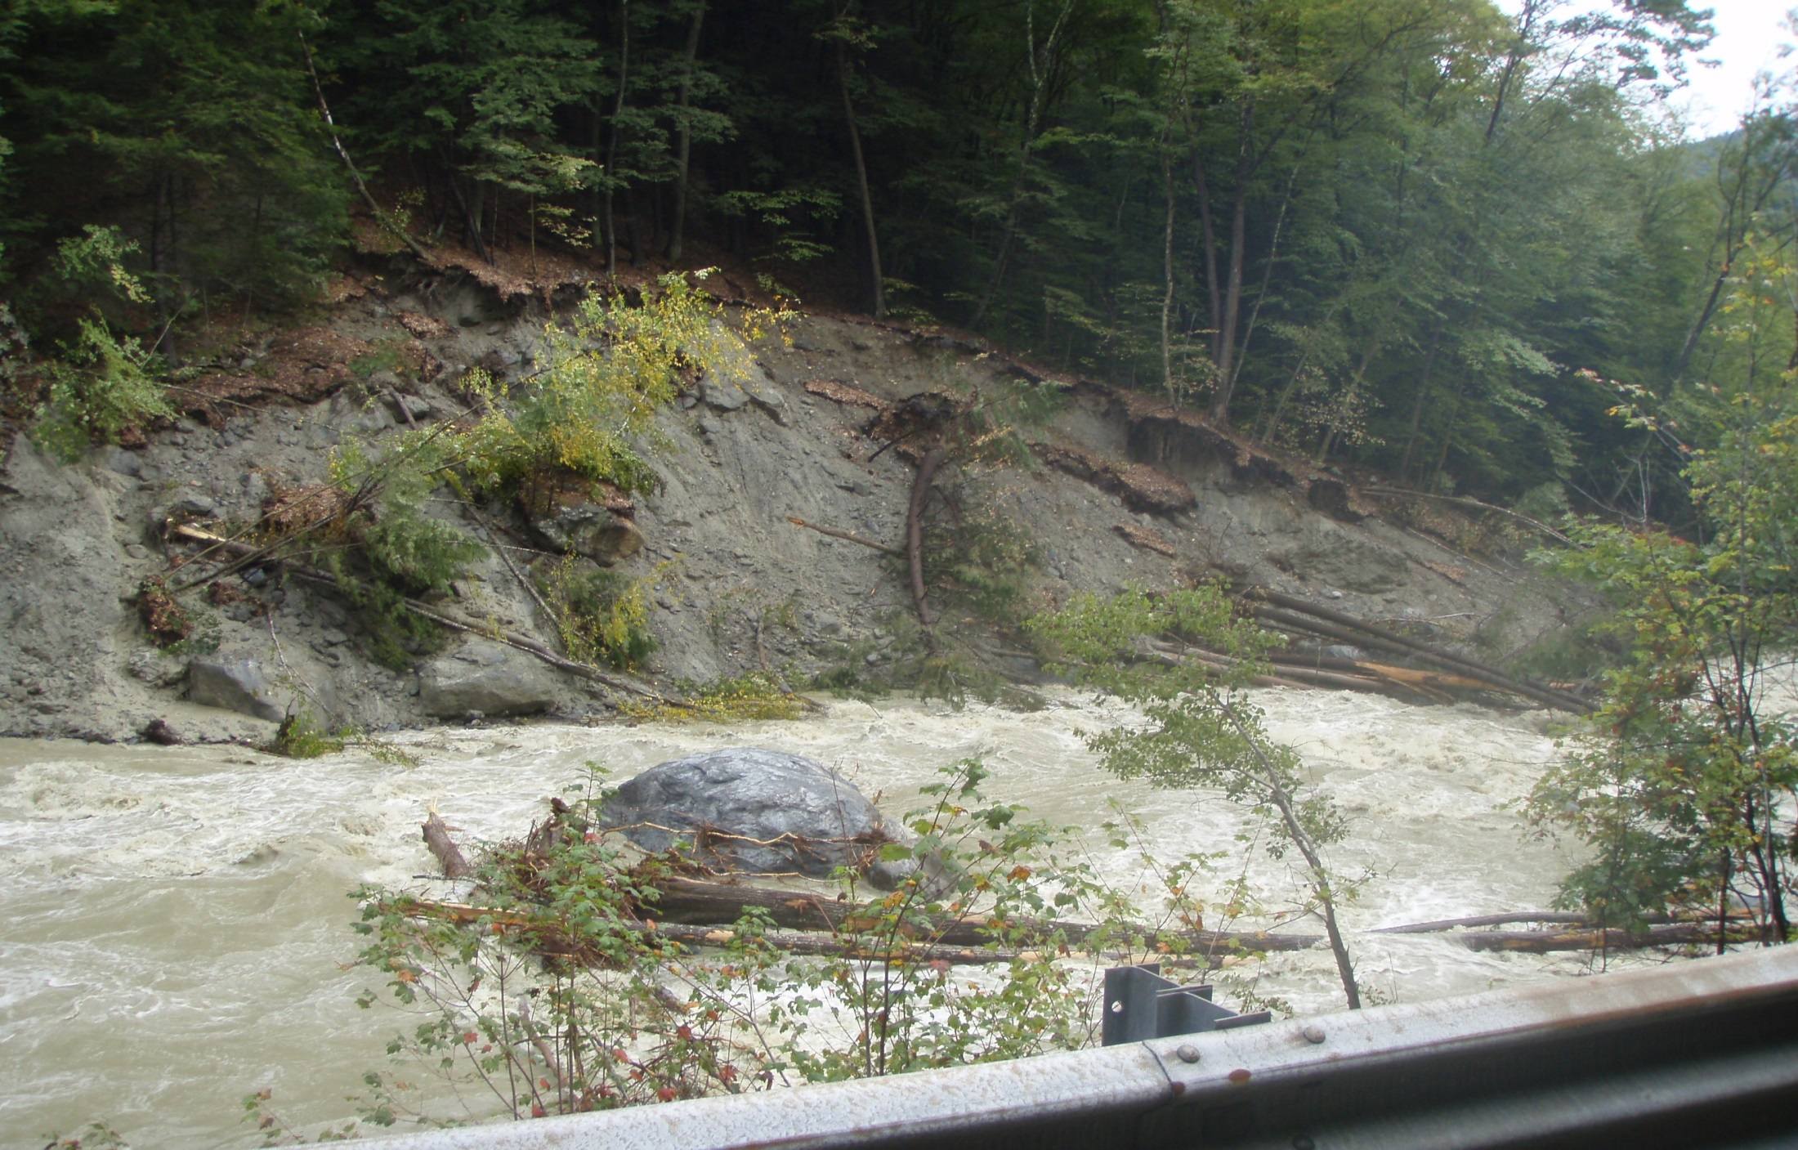
Natural Resource Impacts!
Photo by J. Kopera

Slide 24
Slide Courtesy: NOAA-RFC

Slide 25
Slide Courtesy: NOAA-RFC

Slide 26
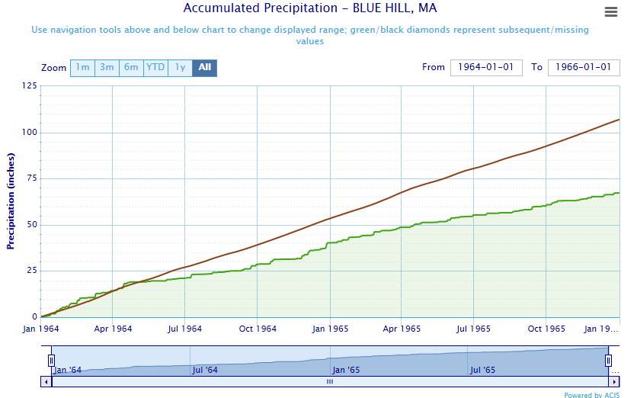
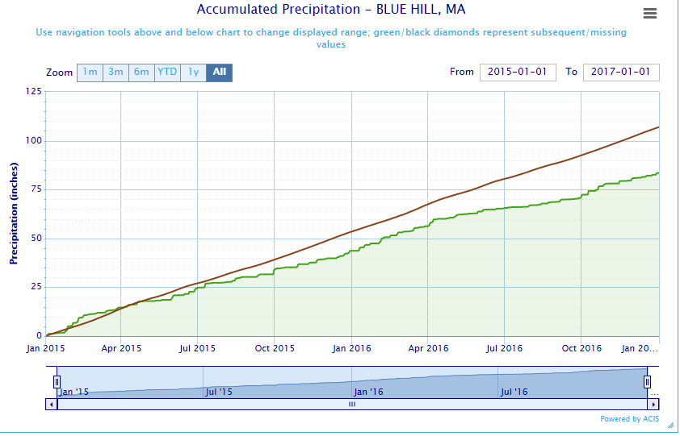
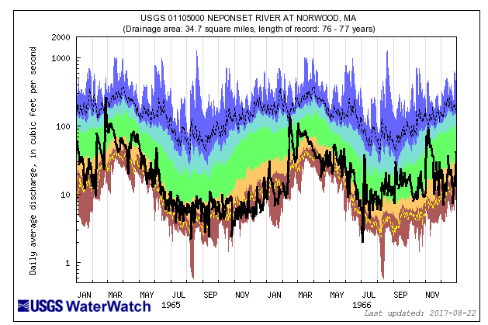
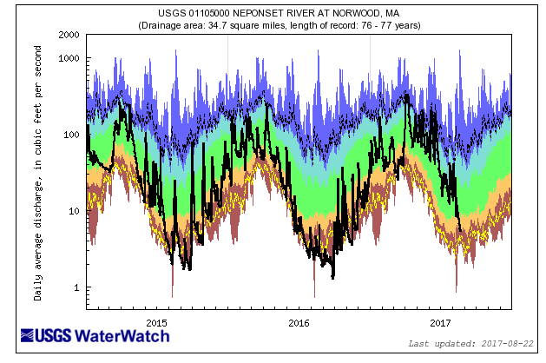

Local Basin Development/Drought (Norwood, MA)
50” Deficit
25” Deficit
1960s Drought
2015-2017 Drought
Slide Courtesy: NOAA-RFC

Slide 27

So what is going on?
How should Massachusetts address its new hydrological regime and impacts?
What should we do at the state and local levels?

Slide 28
Understanding the Problem………its really basic!
Impacts from Typical Development
Pre-Development

Slide 29
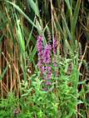
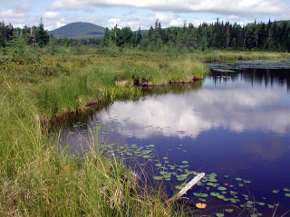
Some recent research & thoughts
Precipitation although below average is still having greater impacts today than during the drought of record …… only difference is Land Use changes!
Shallow upland soils/sediment are major contributors to streamflow and aquifer recharge
Water in streams does not get there by ‘running off’ over the land surface but subsurface from hillslopes, stormwater flow
The BOTTOM LINE!
Land Use Matters ……a LOT!
Open Space Matters!!
Where development occurs Matters!
What we protect Matters!

Slide 30
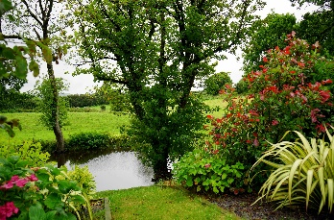
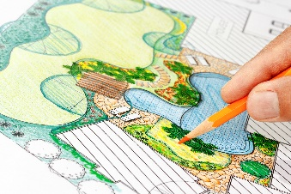
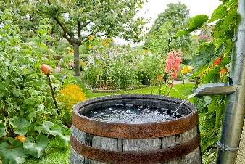
Some examples of what can be done at the Local Level
Revise Open Space & Community Development Plans
Protect Upland areas; they are important, and perhaps more
so from a drought perspective
Complete Habitat and Resource area vulnerability assessments
Pass conservation zoning and general wetland protection bylaws/ordinances
Support & initiate ecological restoration projects
Pursue water conservation & stream flow restoration efforts
Partner with DPW to build climate smart infrastructure

Slide 31


Thank you!
VANDANA RAO
Email: vandana.rao@mass.gov
Website: www.mass.gov/eea

